Slide 1
Ethics: Understand your role and stay in your lane
Dana E. Prescott, JD, MSW, PhD*
dana@southernmainelaw.com
Diane a. Tennies, Phd, LADC
datphd@aol.com
March 20, 2019
*opinions provided by the speakers for this training may not be the opinions of the GAL Review Board or any other Supervisory authority

Slide 2
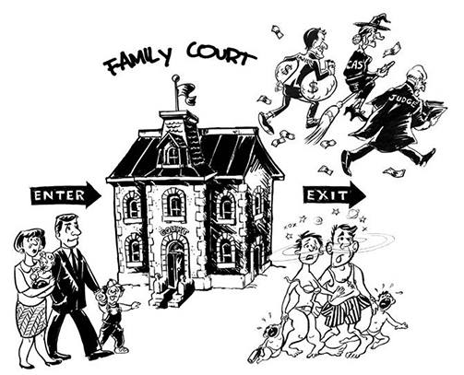
Overview of themes
Family court cases are bench trials-one judge/one fact-finder.
Families may perceive family court from many mediums few of which are accurate.
What is the “role” and “lane” of GALs as Investigators and when making recommendations?
What are your values and Biases and their impact?

Slide 3
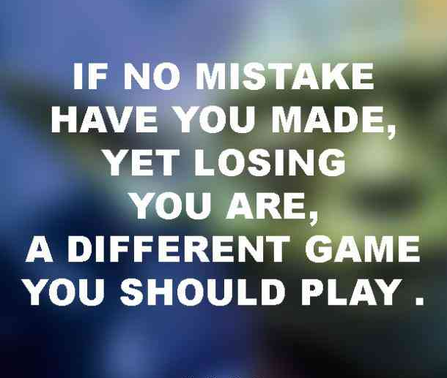
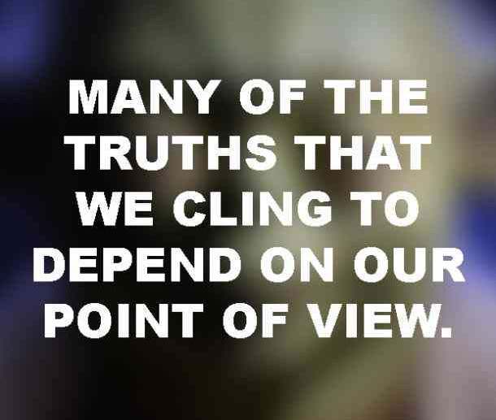
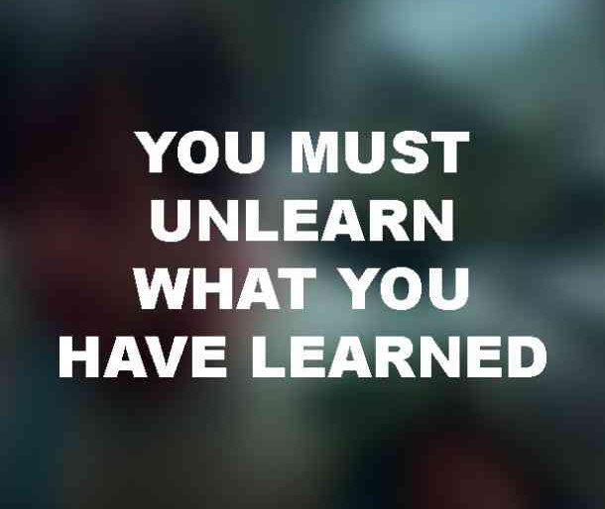

Slide 4
GAL Best Practices
Knowledge
Research, Generalizability, Bias, Reliability, Validity
Investigate
Multi-Source Data Collection, Ethics, Respect for Diversity
Judicial decision making
Informed, Fact-Based, Bounded-by-Law
Parenting Plan
Data + BICFs +
Interventions=
Recommendations

Slide 5
Beginning thoughts
This module is an overview of the legal and ethical standards and rules and suggestions for best practices.
If you have questions then consult or get supervision from a qualified colleague. Or contact Angela Morse, esq. who serves as special Counsel for the GAL Review Board who provides informal guidance.
Suggestions for improving the GAL Rules are welcome by the GAL Review Board who can be reached at: https://www.mebaroverseers.org/gal_review_board/index.html

Slide 6
The Appointment Order [AO]
RULE 4(a). An individual shall act in a case as a GAL only as authorized by:
(1) A limited purpose appointment order pursuant to Rule 4(b)(4)(D)(i), 4 M.R.S. § 1555, and either 19-A M.R.S. § 1507 or 18-A M.R.S. § 1-112;
(2) A standard appointment order pursuant to Rule 4(b)(4)(D)(ii), 4 M.R.S. § 1555, and either 19-A M.R.S. § 1507 or 18-A M.R.S. § 1-112;
(3) An expanded appointment order pursuant to Rule 4(b)(4)(D)(iii), 4 M.R.S. § 1555, and either 19-A M.R.S. § 1507 or 18-A M.R.S. § 1-112; or
(4) An appointment order pursuant to Rule 4(c), 4 M.R.S. § 1556, and 22 M.R.S. § 4005.

Slide 7
Case Law: The Court is the Client
Gerber v. Peters, 584 A.2d 605, 607 (Me. 1990) (“The duty of a court appointed guardian ad litem of a minor child in a divorce case is to the court, and the scope of that duty lies within the parameters of the order of appointment.“).
Miller v. Miller, 677 A.2d 64, 69 n.8 (Me. 1996) (A GAL’s “central responsibility is to assist the court in its role as parens patriae to determine the best interests of the child(ren).”).
Richards v. Bruce, 691 A.2d 1223, 1226 (Me. 1997) ("The guardian serves as the court's agent and prepares a report for the court detailing his or her findings.")
Kennedy v. State, 730 A.2d 1252, 1255 (Me. 1999) (The GAL “has traditionally been viewed as functioning as an agent or arm of the court, to which it owes its principal duty of allegiance, and not strictly as legal counsel to a child client.”).

Slide 8
4 M.R.S. §1554(3)
A person appointed by the court to serve as a GAL acts as the court's agent and is entitled to quasi-judicial immunity for acts performed within the scope of the duties of the GAL.
As a quasi-judicial officer, the GAL shall perform the assigned duties independently and impartially in all relevant matters within the scope of the AO, respecting the court's obligation to dispose of all judicial matters promptly, efficiently and fairly as provided in the Maine Code of Judicial Conduct.

Slide 9
The AO Controls the scope of Duties
This is critical and a common ‘error’ of GALs – remember if you go outside the AO scope you no longer have immunity.
Do not rely on the attorneys – Review the AO to ensure these pieces are included. It is common to have to amend the AO.
M.R.G.A.L. 4(b)(4)(A) (“The GAL may not perform and shall not be expected to perform any duties beyond those specified in the appointment order, unless subsequently ordered to do so by the court.”).
4 M.R.S. §1556(2)(A) (“The appointment order must be written on a court-approved form and must specify the GAL’s length of appointment and specific duties, including the filing of a written report.”).

Slide 10
What about Implied Authority?
Example 1: The AO directs the GAL to interview both parents but makes no mention of third persons. the mother wants the GAL to interview other witnesses and her parents but none of them reside with her. Yes or no?
Example 2: The AO directs the GAL to interview the child’s therapist. the lawyers have agreed that you will also review the parents’ mental health records. Yes or no? [Second question: What about Confidentiality of these records?].
Example 3: The AO directs the GAL to write an interim report for mediation but not to attend mediation (or a judicial settlement conference). Should the GAL attend mediation if demanded by the attorneys? Yes or No? [And what about trial?]

Slide 11
GAL Reports: Admission and Timing
You are required to provide a report (when ordered by the court) in advance of the hearing (usually 14 days)
Reports are admissible as evidence and subject to cross-examination and rebuttal
See: 4 M.R.S. §1555(6), 19-A M.R.S. §1507(5), 18-A M.R.S. §1-112(e) 22 M.R.S. §4005(1)(D) for specific language

Slide 12
Mandated Reporting and Confidentiality: The need for Supervision
Rule 5(f): Pursuant to 22 M.R.S. §4011-A, while acting in their professional capacity as GALs, GALs are mandated reporters.
Rule 5(g):
A GAL Shall observe all statutes, rules, and regulations concerning confidentiality.
A GAL shall not disclose information or participate in the disclosure of information relating to a case to any person who is not a party to the case, except as necessary to perform the GAL’s duties, or as may be specifically provided by law or by these Rules.
Communications made to a GAL, including those made to a GAL by a child, are not privileged.

Slide 13
The GAL’s Trial Role
In re Adoption of T.D., 2014 ME 36, ¶18, 87 A.3d 726:
The most effective challenge to the quality, completeness, or competence of a GAL’s work will be accomplished through cross-examination of the GAL at trial.
If a parent has filed a motion to remove the GAL or otherwise challenge the GAL’s investigation, the court can, and should, hear the motion during the trial and allow examination of the GAL on the pertinent issues.
If the court concludes the investigation has been insufficient or that the GAL has demonstrated a bias that has made the testimony unreliable, the court may disregard that testimony in whole or in part.

Slide 14
GALs are not Truth Detectors or experts (under State v. Williams and its Progeny)
State v. Black, 537 A.2d 1154, 1157 n.1 (Me. 1988) (“We note that a significant number of jurisdictions have recognized that although an expert may testify in order to explain inconsistent conduct or testimony of the victim, the expert cannot offer an opinion as to the truth of the victim’s story.”) (emphasis added).
The test for determining when an expert is qualified and the expert testimony is admissible:
(1) the testimony is relevant pursuant to M.R. Evid. 401, and
(2) it will assist the judge in understanding the evidence or determining a fact in issue.
To meet the two-part test, the testimony must also meet a threshold level of reliability because if an expert’s methodology or science is unreliable, then the expert’s opinion has no probative value.

Slide 15
Selected Current events
see McMahon v. McMahon, 2019 ME 11, ¶36 (Alexander, J. dissenting) (“Without providing the parties with notice or an opportunity to be heard, or any findings justifying its actions, the final court order disregarded the earlier orders setting limits on the work authorized and payments to the guardian ad litem. The final order, in effect, signified a return to the abusive, open-ended guardian ad litem fee-setting practices that prevailed prior to the Douglas and Desmond opinions and the reforms that followed those opinions.”).
(Rago) Sedgewick v. Rago, Yor-18-327 (Mem. Dec. February 27, 2019) (Appeal from referee; oral argument)
Oral argument held in case related to admission of GAL reports and testimony and Conflicts rules (pending).

Slide 16
Your professional Ethical Code and the GAL Code are Binding
A Code articulates a profession’s mission, values, principles and standards and thereby defines duties and liabilities of the professional.
By articulation of core values and binding ethics, a Code provides guidance and rules for practitioner conduct.
a Code describes activities that constitute best practices and the way such activities should be properly and ethically undertaken.
A Code is a full disclosure statement that describes and proscribes the ethical deployment of professional responsibilities.
Adapted from Marsh, J. C. (2003). Editorial: To Thine Own Ethics Code Be True. Social Work, 48(1), 5-7.

Slide 17
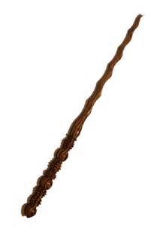
Tips for GALs
Families and GALs are entitled to dignity and respect in the investigation, report, and courtroom:
Never say or write anything unless you are prepared to have it recorded and replayed in court.
Never use denigrating language or labels like “poor” or “personality disordered.”
Never use a diagnosis or label unless you have a current authenticated report and not guesses about someone the therapist or witness never met.
Never tell one lawyer something “off the record” unless you would say the same to the other lawyer.
Never assume that what you are told in a call by a professional or layperson will be testified to under oath in court.
Never move out of your professional lane So always ask the court for clarification and assistance.
Never confuse your values with your ethical Duties under GAL Rules.
Never confuse your role as the judge or a magic wand.

Slide 18
always Respect and account for diversity and vulnerability

Slide 19
Be aware of Bias
Bias is a function of the brain as it processes and filters information with cognitive shortcuts necessary for everyday functioning
These cognitive and emotional short cuts influence our decision-making
Bias is not an excuse for prejudice or bigotry or reaching conclusions unsupported by data

Slide 20
Explicit and implicit Bias
Explicit biases like sexism or racism had become less prominent but that does not mean these are forgotten in policy and practice.
Implicit biases influence our observations, understanding, decision making, and behavior, without our even realizing it.
Implicit bias is driven by attitudes and stereotypes that we have about social categories, such as poverty, gender, and race:
An attitude is an association between some concept (for example, gender) and an evaluative valence, either positive or negative.
A stereotype is an association between a concept (for example, gender) and a trait.
Kang, J., Bennett, M., Carbado, D., & Casey, P. (2011). Implicit bias in the courtroom. UCLA Law Review, 59, 1124-1186.

Slide 21
questions

Slide 22
REFERENCES
Marcia Boumil et al., Legal and Ethical Issues Confronting Guardian ad Litem Practice, 13 J. Law & Fam. Studies 43 (2011).
Richard Ducote, Guardians ad litem in Private Custody Litigation: The Case for Abolition, 3 Loy. J. Pub. Int. L. 106 (2001).
Dana E. Prescott & Neil D. Jamieson, Divorce in Maine: The Legal Process, Your Rights, and What to Expect (2015).
Dana E. Prescott, Inconvenient Truths: Facts and Frictions in Defense of Guardians Ad Litem for Children, 67 Me. L. Rev. 43 (2014).
Dana E. Prescott, The New Phoenix: Maine's Innovative Standards for Guardians Ad Litem, 69 Me. L. Rev. 67 (2017).
Margaret E. Sjostrom, What’s a GAL to do?: The Proper Role of Guardians Ad Litem in Disputed Custody and Visitation Proceedings, 24 Child. Leg. Rights J. 2 (2004) .
http://www.courts.maine.gov/rules_adminorders/rules/index.shtml; http://mebaroverseers.org/regulation/gal_rules.html; http://www.courts.maine.gov/fees_forms/forms/index.shtml#fm.

